Slide 1
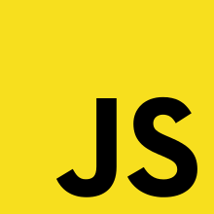
JS Event loop
David.L

Slide 2
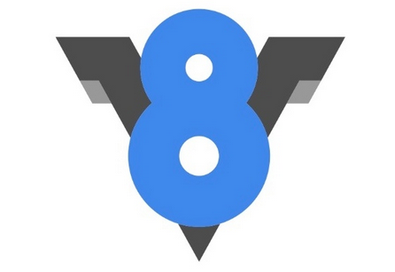
Heap
Stack
Method()
Method()
Method()
Method()
Method()
Method()

Slide 3


API’S
Heap
Stack
DOM
AJAX
Method()
Method()
Event loop
Method()
setTimeout
Method()
Method()
Method()
Callback queue
OnClick
OnHover
$.get

Slide 4
The callStack
One thing at a time…?

Slide 5
Myfile.js
Stack
function multiply(a, b){ return a * b; }
function square(n){ return multiply(n, n); }
function printSquare(n){ return console.log(square(n)); }
printSquare(2);
multiply(2, 2)
square(2)
Console.log(4)
Main()
printSquare(2)

Slide 6
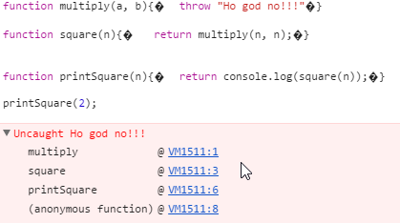
function multiply(a, b){ throw "Ho god no!!!“ }
function square(n){ return multiply(n, n); }
function printSquare(n){ return console.log(square(n)); }
printSquare(2);

Slide 7
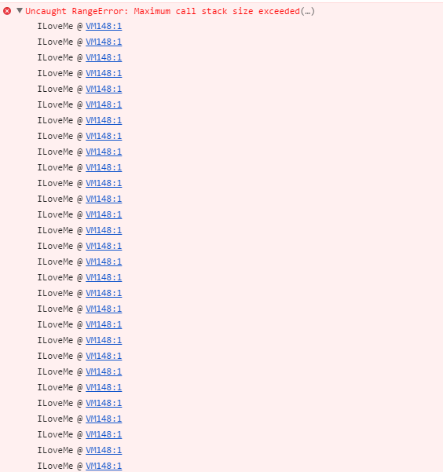
ILoveMe()
ILoveMe()
ILoveMe()
Function ILoveMe (){ ILoveMe() }
ILoveMe ()
ILoveMe()
ILoveMe()
ILoveMe()
ILoveMe()
ILoveMe()
ILoveMe()

Slide 8
Myfile.js
Stack
Console.log(‘Sup’)
setTimeout(function(){ console.log(‘World ’) }, 5000)
Console.log(‘Hello’)
Console.log(‘hello’)
setTimeout
Console.log(‘World’)
Console.log(‘sup’)

Slide 9
Myfile.js
Stack
API
Console.log(‘Sup’)
setTimeout(function(){ console.log(‘World ’) }, 5000)
Console.log(‘Hello’)
setTimeout
Console
Console.log(‘hello’)
setTimeout
Console.log(‘World’)
Console.log(‘sup’)
sup
Hello
Task queue
World
Function(){...}
Event loop

Slide 10
setTimeout(…, 0) ??

